Slide 1
Project A
Dan yeoell
Cybersecurity Bootcamp

Slide 2
Executive summary
I have been hired by an IT company who wants to upgrade their IT systems, but the client has a limited budget and no more physical space to install new equipment. My suggestion is to implement virtual machines instead of more hardware; this will help reduce costs and to meet the client’s operational needs. Part of the upgrade includes: installing a Firewall, a PC for the CEO, a Webserver, DNS server, and some Linux machines for monitoring and conducting cybersecurity related tasks.

Slide 3
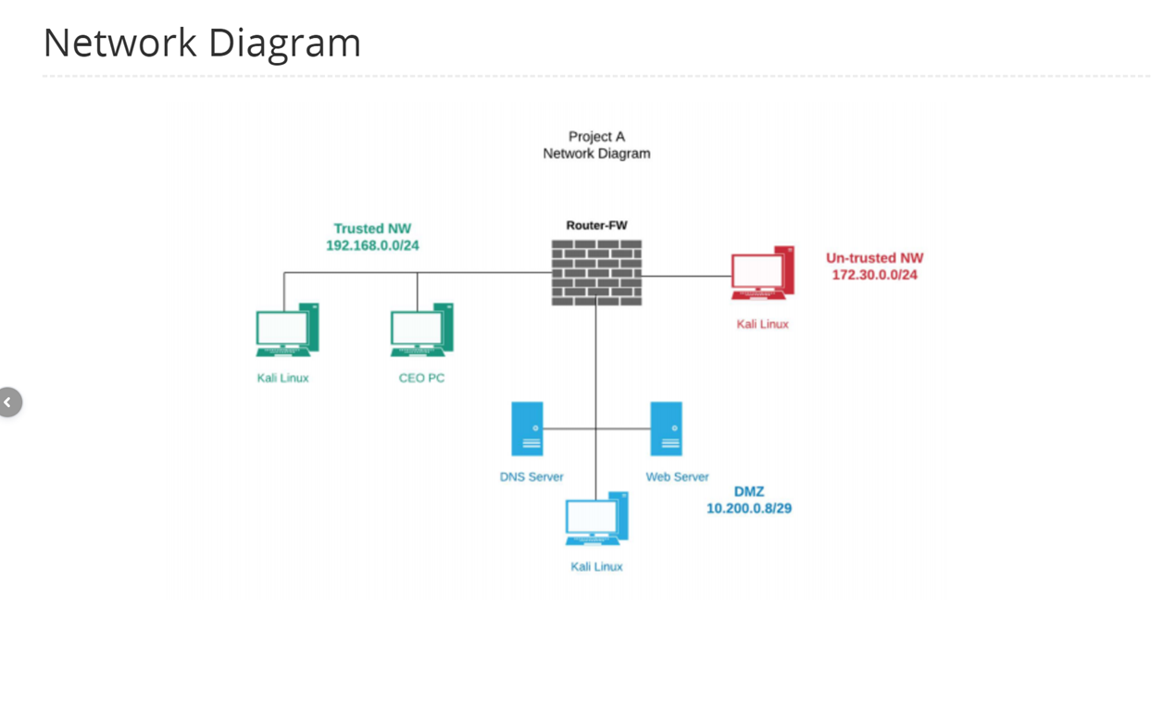
What we created
Upgraded the clients system by installing a Firewall, a PC for the CEO, a Webserver, DNS server, and some Linux machines for monitoring and conducting cybersecurity tasks.

Slide 4
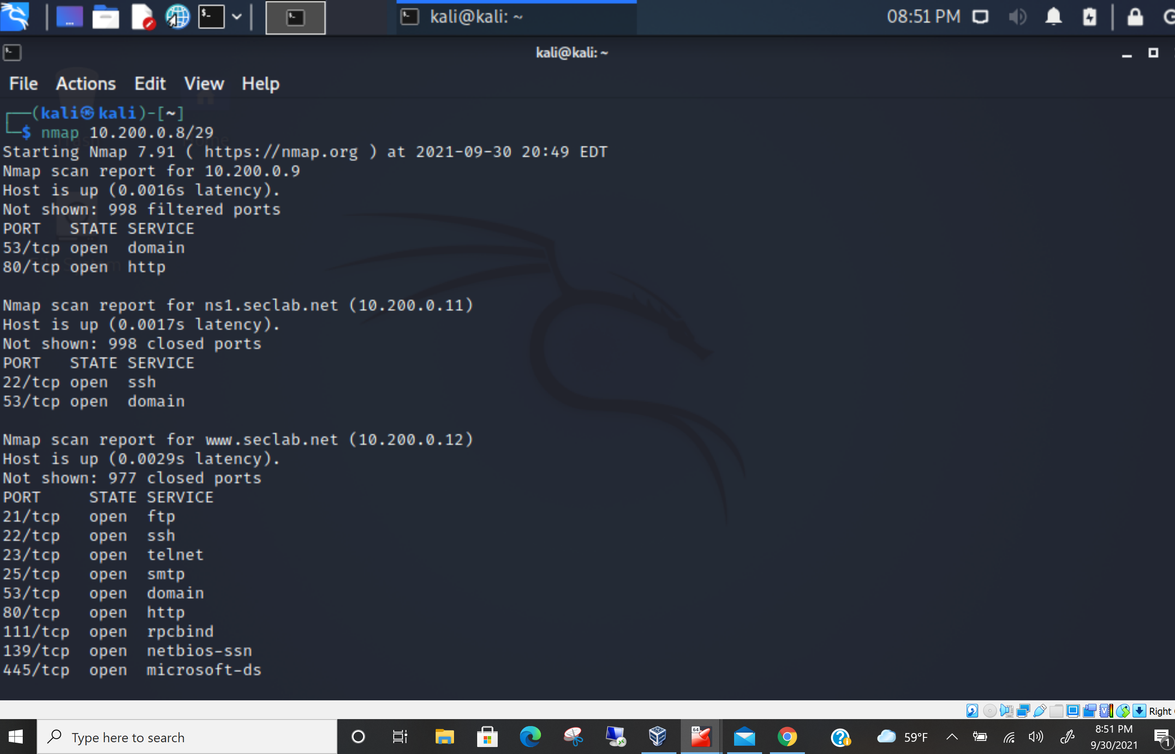
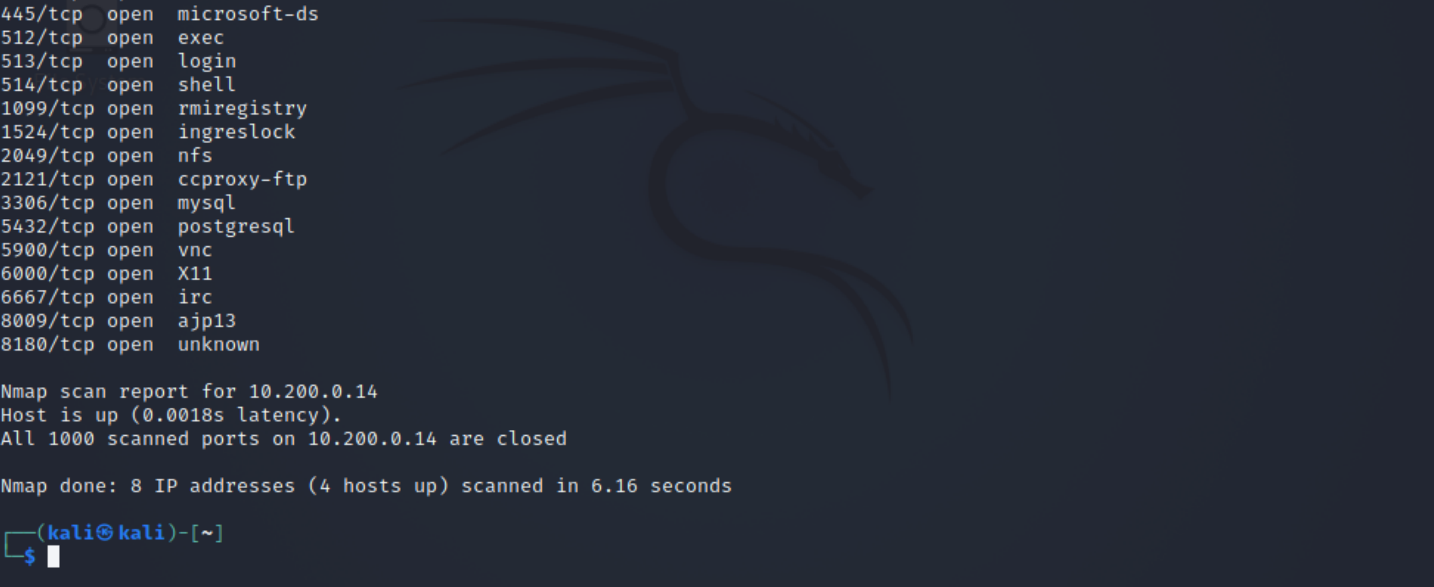
Nmap scan
Nmap is used to identify what devices are running on the systems, discovering hosts that are available, finding open ports and detecting security risks.
Nmap 10.200.0.8/29 (trusted)

Slide 5
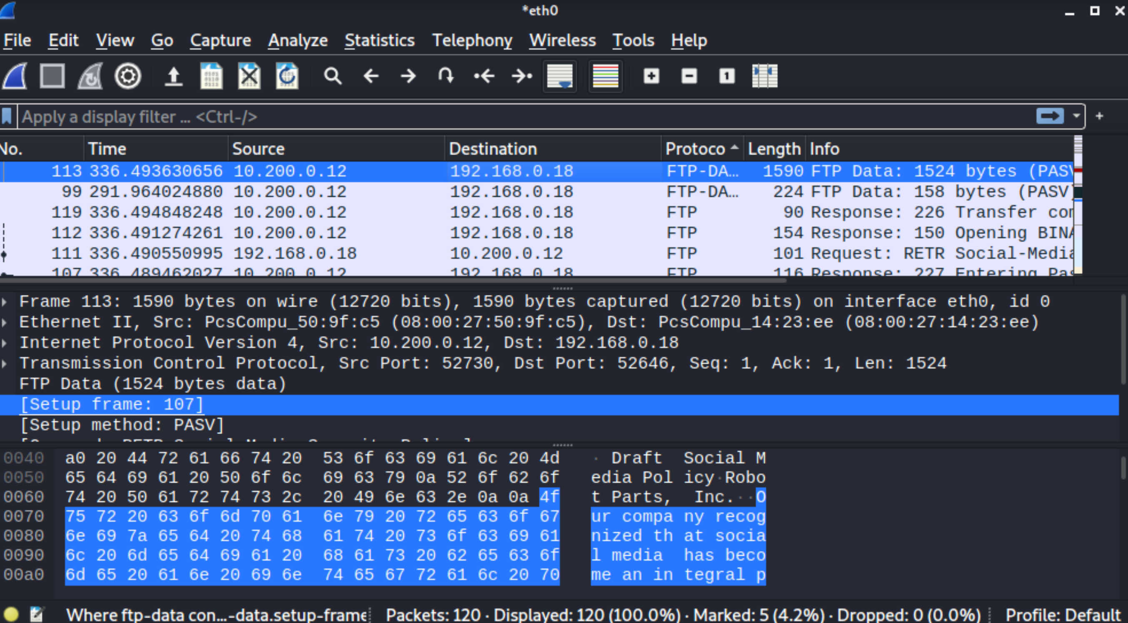
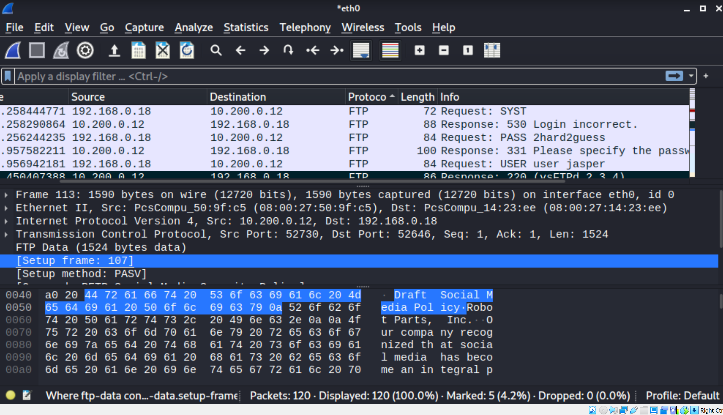
wireshark
Wireshark is a packet sniffer and analysis tool that shows us the FTP file transfer between CEO PC and web server here.

Slide 6
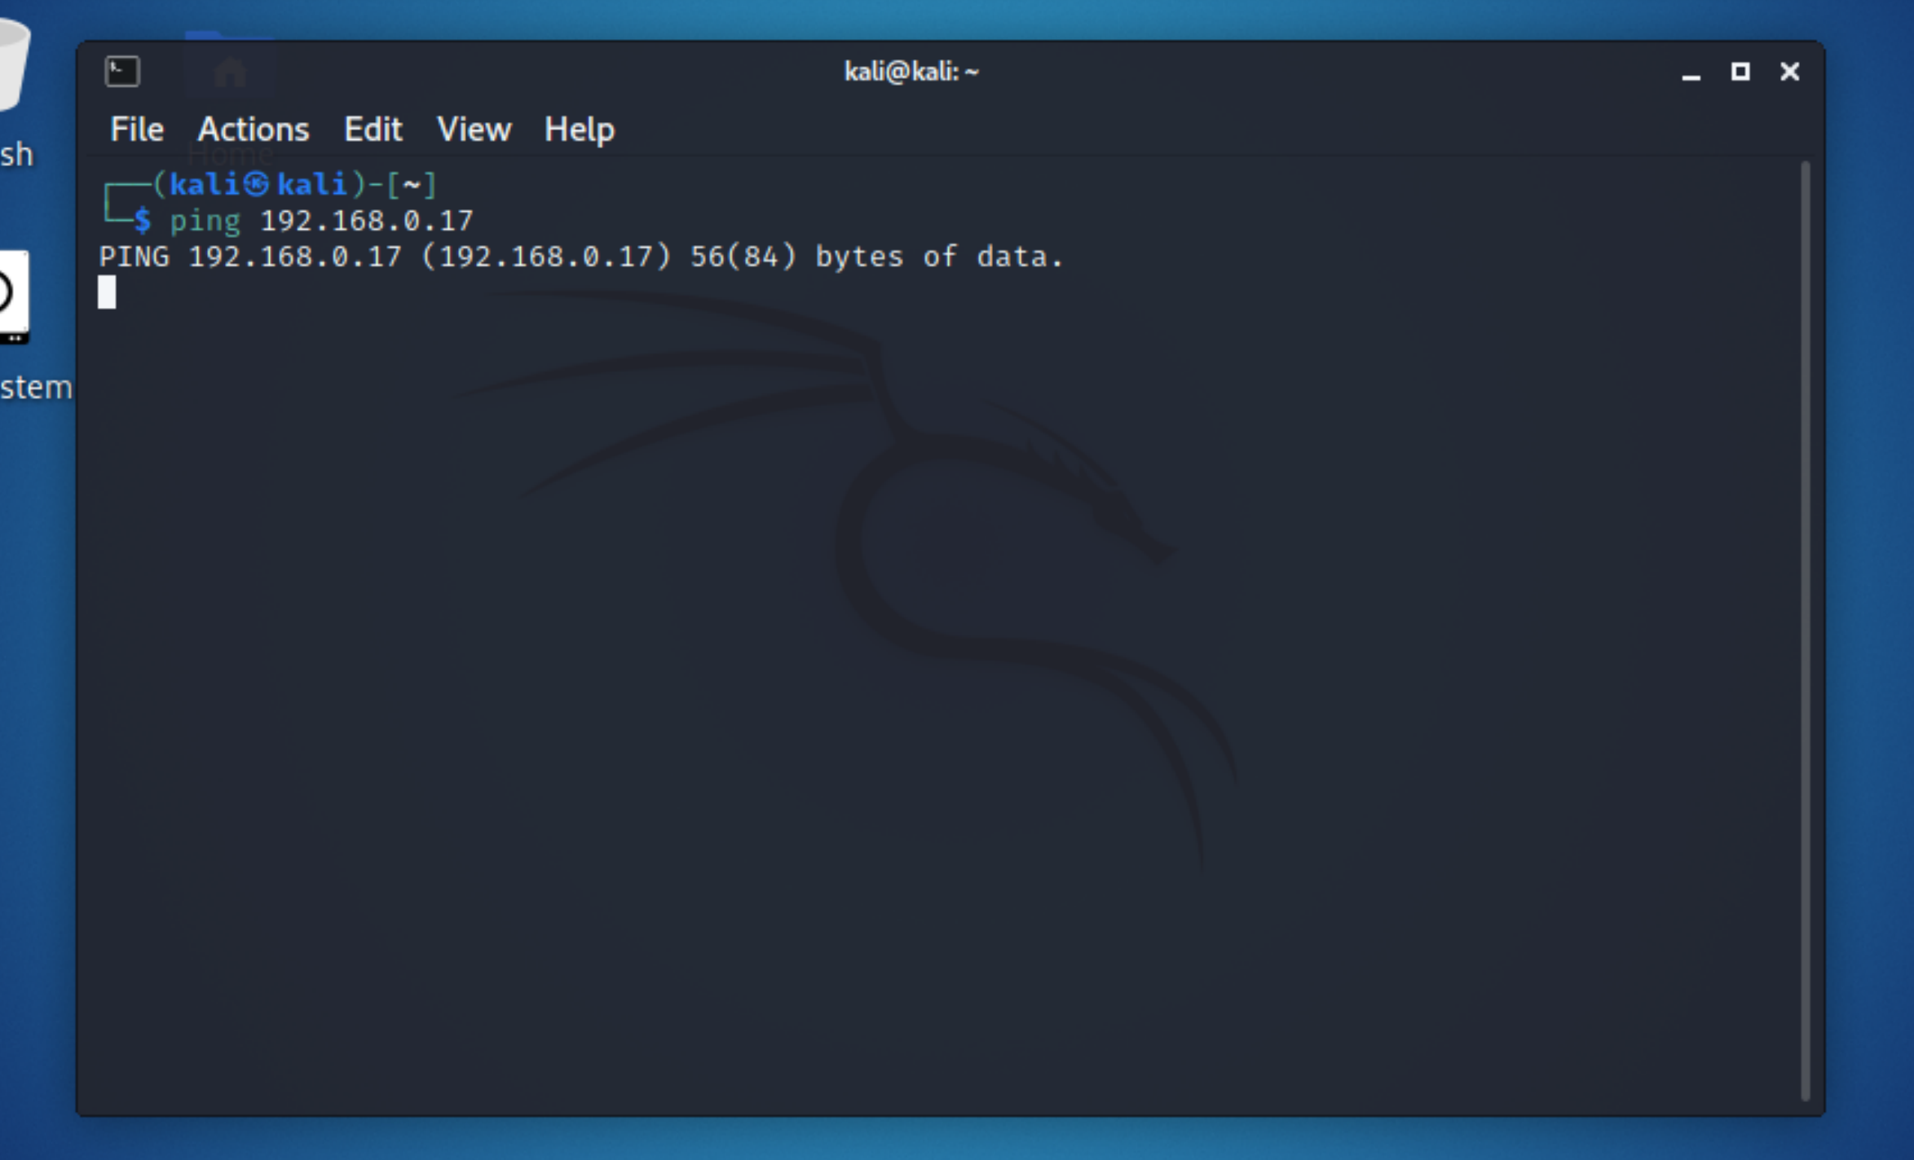
Verify Trusted network is protected from untrusted network
By logging into 192.168.0.1and configuring the Firewall rules (block, address family IPV4 and IPV6, Any source) and confirming by using the ping command I was able to confirm the trusted network was protected.

Slide 7
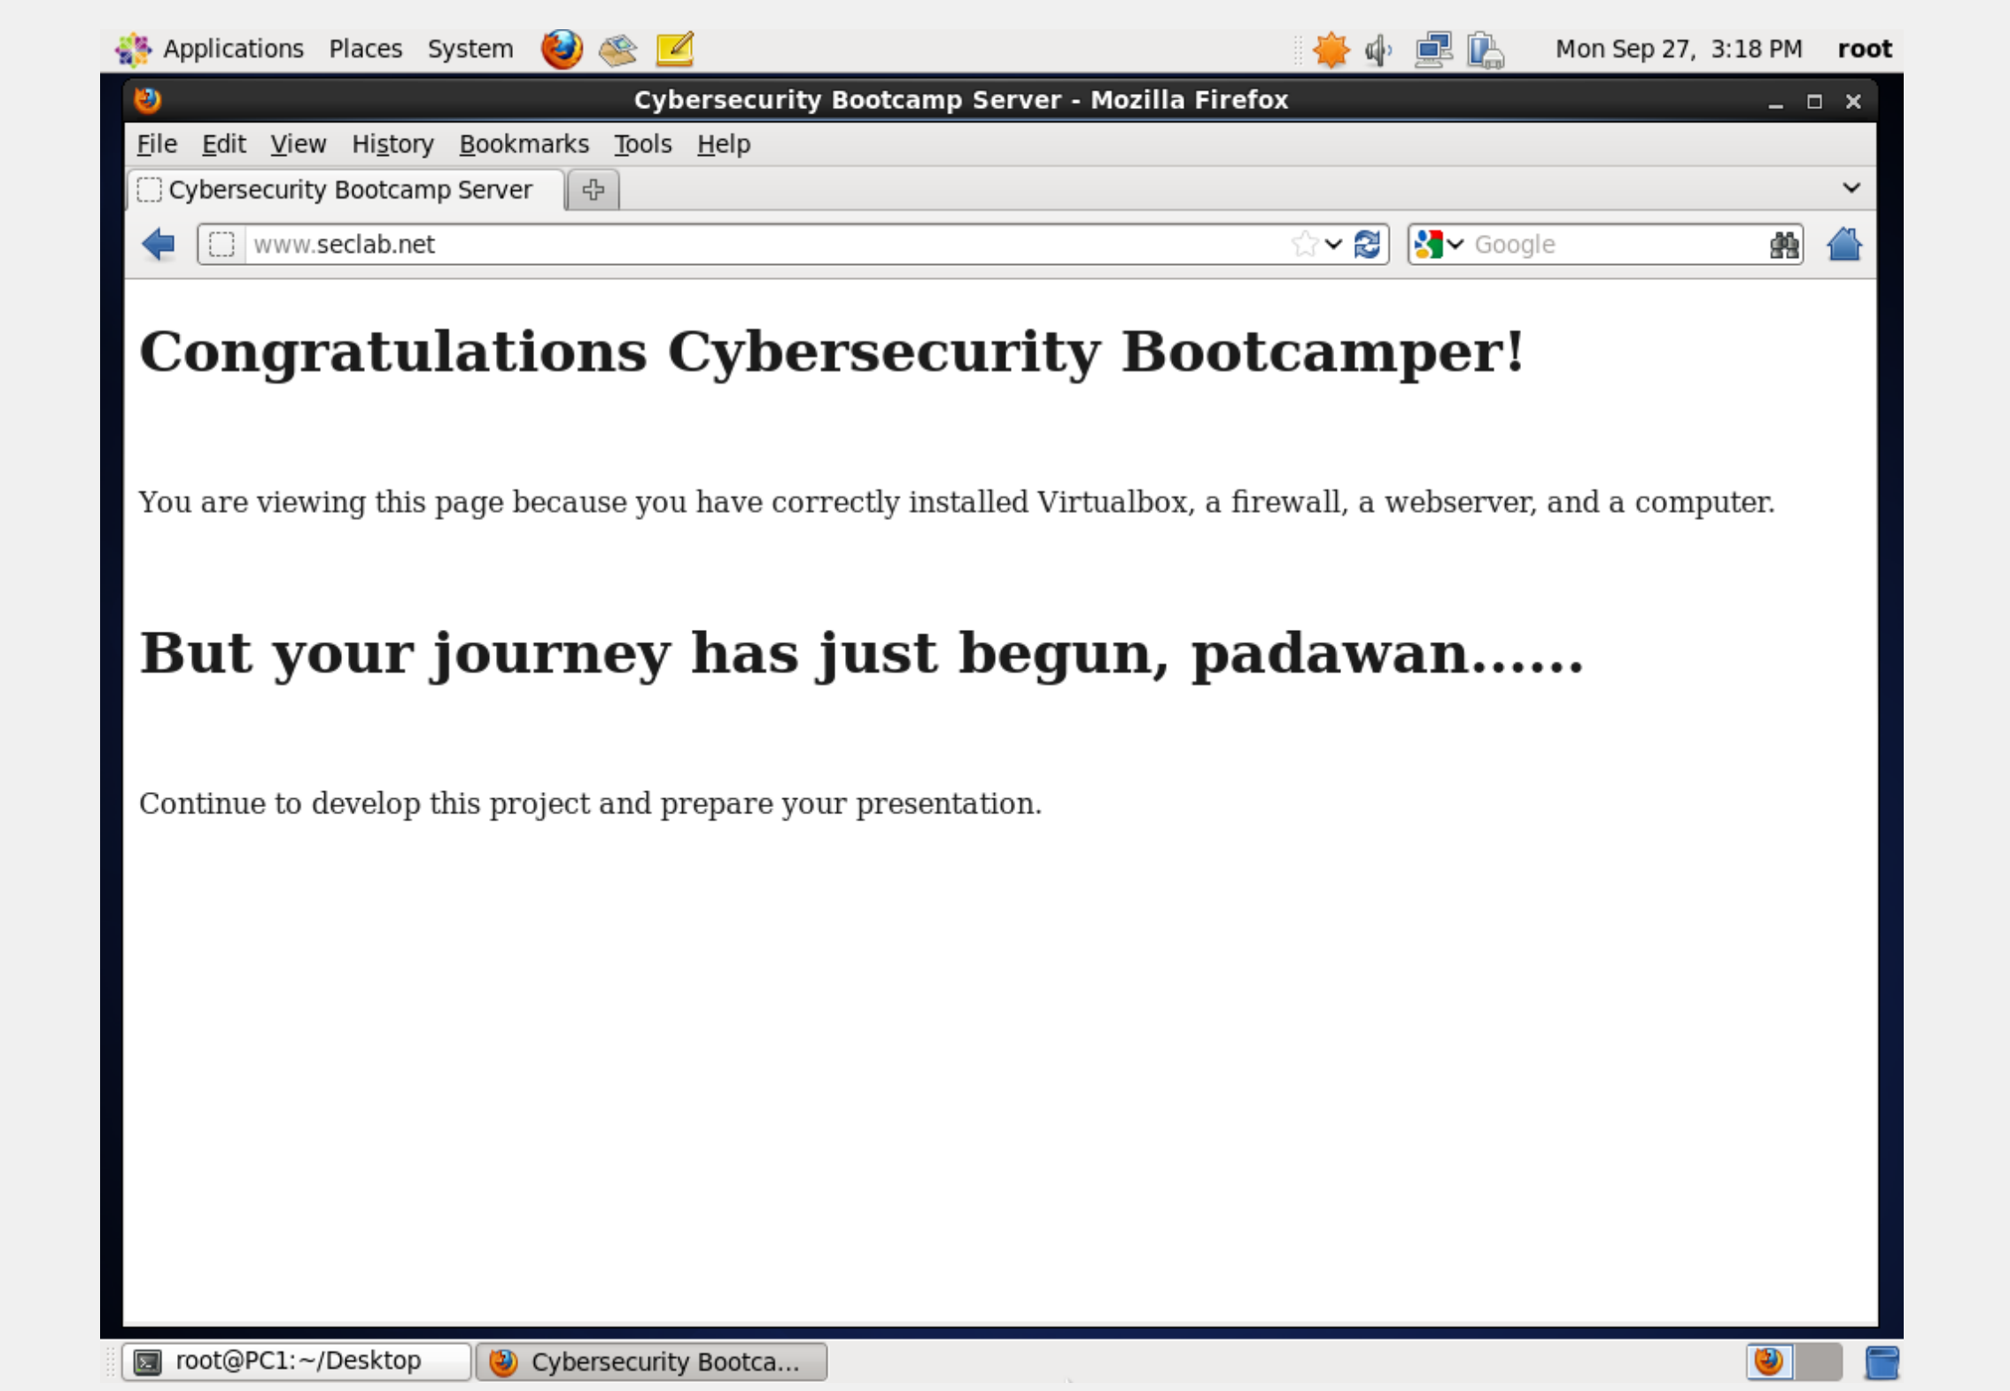
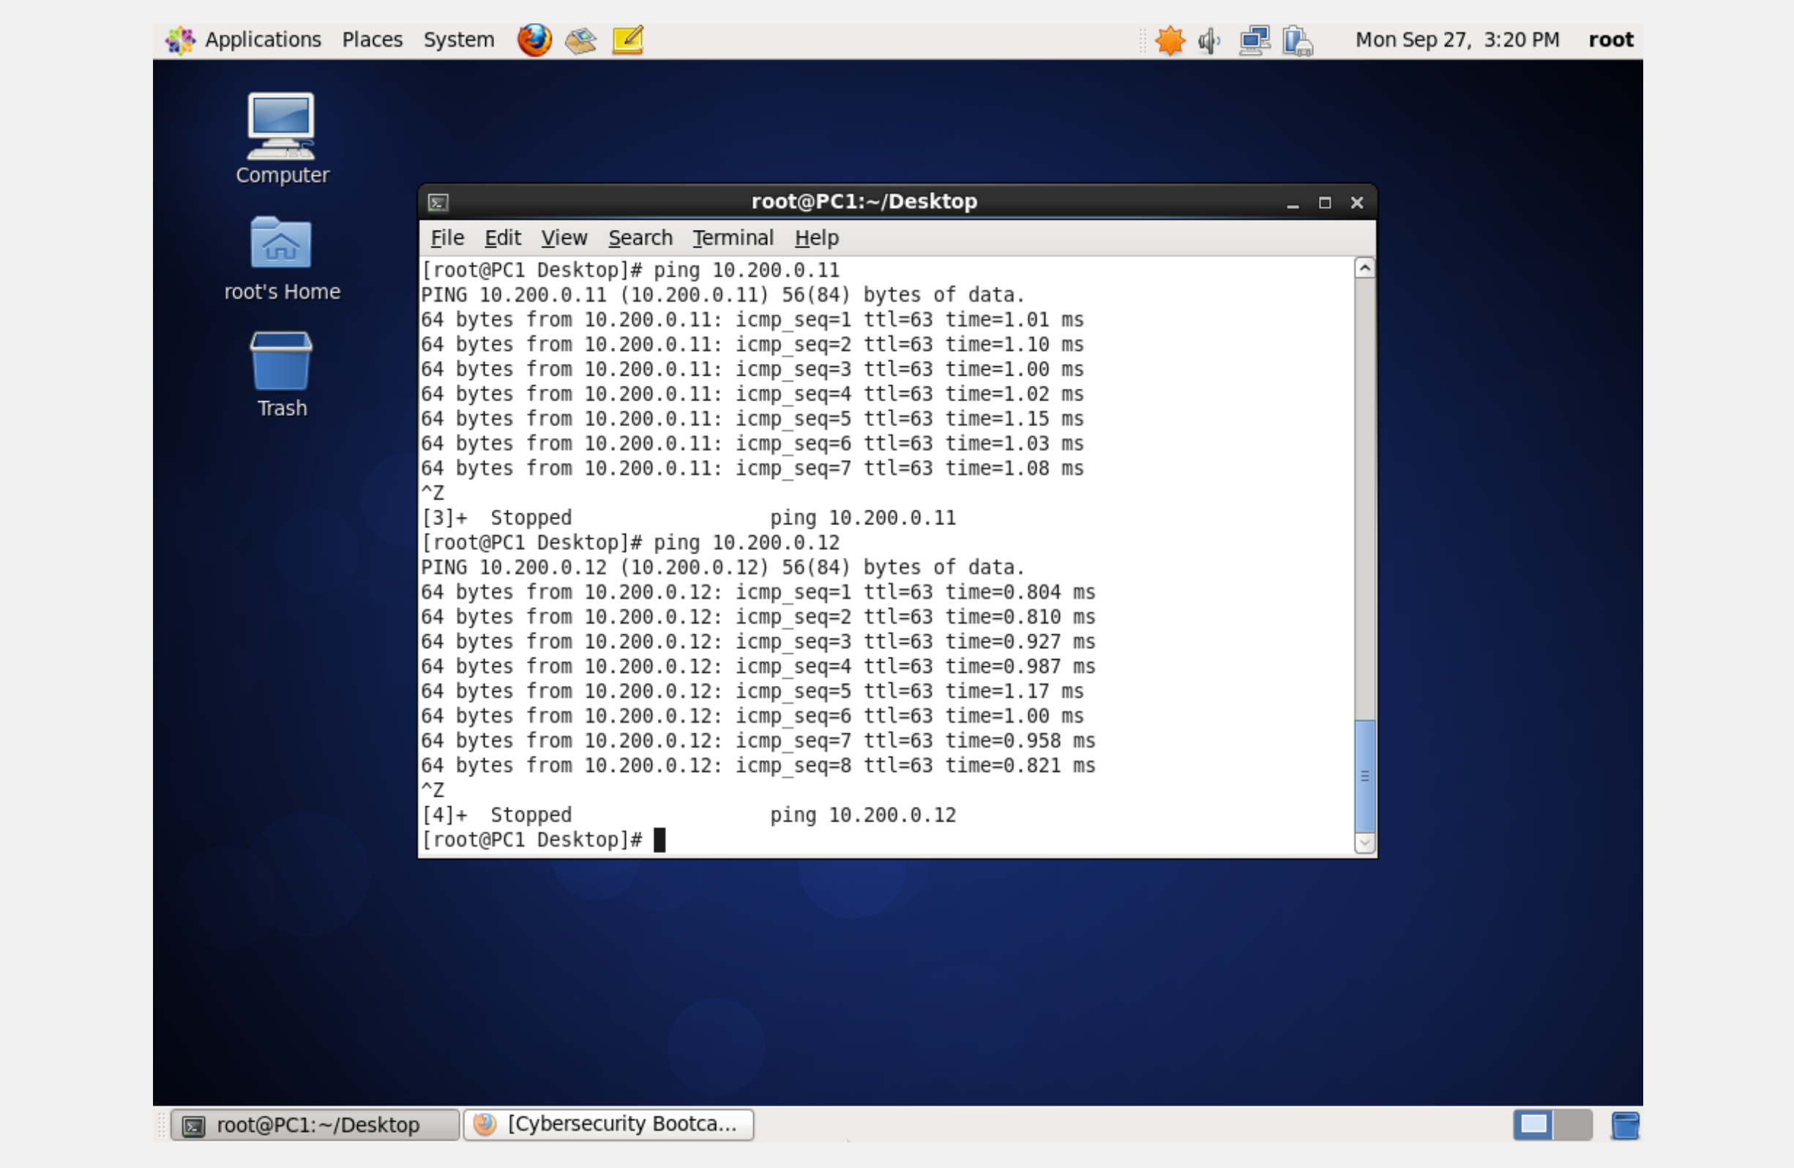
Problems identified and resolutions
Troubleshooting CEO PC www.seclab.net
By clicking the computers at the top of the screen to change the network connection to Auto and fixing the IP config I was able to get the webpage up and running.

Slide 8
Extra
Common Port numbers:
21: FTP Server.
22: SSH Server (remote login)
25: SMTP (mail server)
53: Domain Name System (Bind 9 server)
80: World Wide Web (HTTPD server)
110: POP3 mail server.
143: IMAP mail server.
443: HTTP over Transport Layer Security/Secure Sockets Layer (HTTPDS server)

Slide 9
Recommendations/closing remarks
If set up and utilized correctly virtual machines have key benefits. A main advantage being, multiple OS environments can exist simultaneously on the same machine, remote from each other.
Virtual machines can offer easy maintenance, availability, and convenient recovery.

